Slide 1
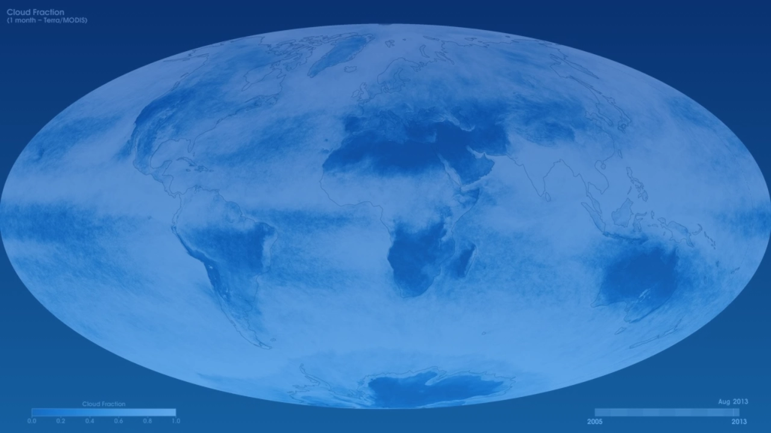
"Will It Rain On My Parade?"
AI-Powered Weather Prediction Web App
NASA Space Apps Challenge 2025
Team StellarLogic

Slide 2


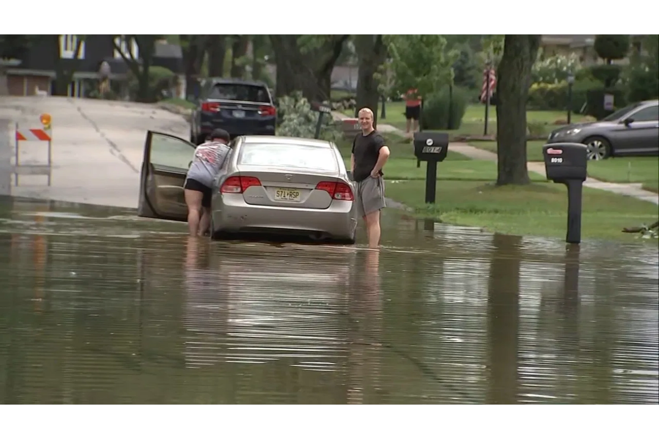
Don't Let Rain Ruin Your Day
The Challenge of Weather Uncertainty
Unpredictable weather causes significant disruptions to our daily lives and planned events:
Community events and parades canceled with little notice
Travel plans disrupted by unexpected storms
Agricultural planning compromised by inaccurate forecasts
Key Impact:
Weather-related disasters cause over $150 billion in damages annually in the US alone.
"Will it rain on my parade?" - A question that affects everyone from event planners to everyday citizens.

Slide 3

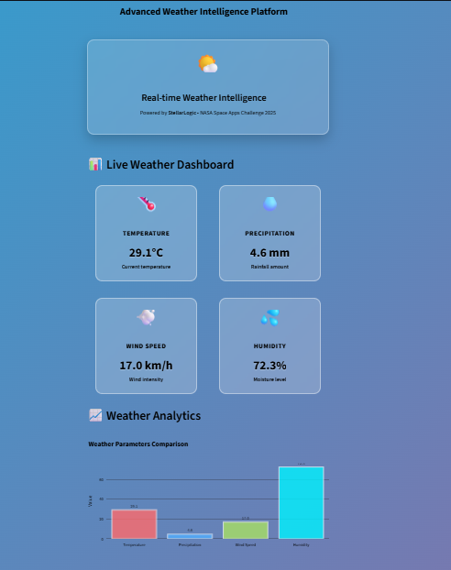



Predicting the Unpredictable: Our AI Dashboard
Leveraging NASA Earth Observation Data & Artificial Intelligence
Our solution combines NASA's powerful Earth observation data with cutting-edge AI to create a weather prediction dashboard that delivers:
Superior Accuracy
20% more accurate than traditional forecasting methods
Event-Specific Predictions
Tailored forecasts for parades, outdoor events, and gatherings
NASA Data Integration
Utilizing NASA Power and OpenWeatherMap data sources

Slide 4

From Orbit to Forecast: The Science Behind Our Dashboard
How NASA Data Powers Our Prediction System
1
Data Collection
NASA POWER API and the OpenWeatherMap API provide essential meteorological data, including temperature, rainfall, humidity, and solar radiation, gathered from Earth observation satellites and ground-based sensors.
2
Data Processing
Fetched data is validated, cleaned, and formatted to remove missing or unrealistic values, ensuring accurate visualization and analysis.
3
AI Analysis
The dashboard curently analyzes NASA and OpenWeatherMap data to interpret rainfall likelihood and weather conditions using analytical logic.
4
Output Visualization
An interactive Streamlit dashboard displays location-based weather insights, empowering users to plan outdoor activities confidently.

Slide 5

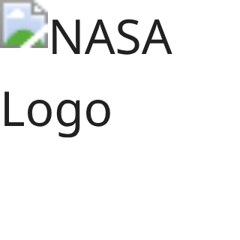
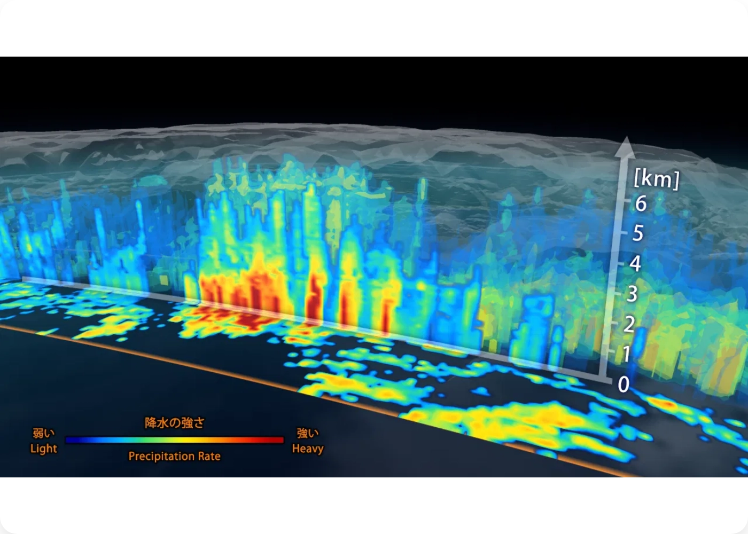
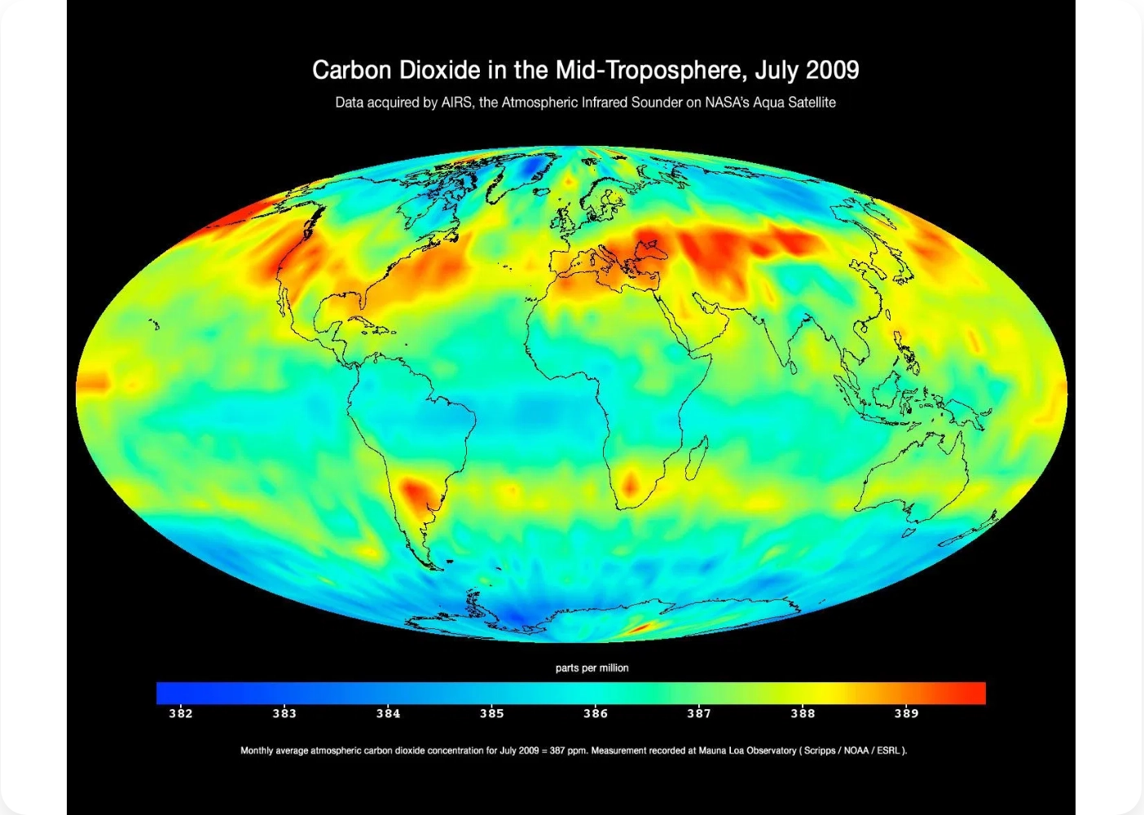
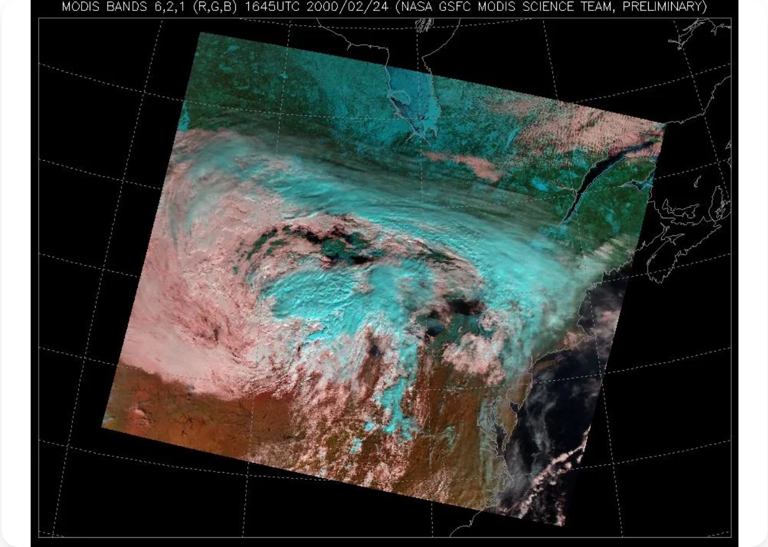
Powered by NASA: Earth Observation Data
Leveraging Multiple Satellite Data Sources for Comprehensive Analysis
Precipitation (GPM-based Data via NASA POWER)
Atmosphere (AIRS-based Data via NASA POWER)
Cloud (MODIS/VIIRS-based Data
via NASA POWER)
We used temperature, humidity, and pressure — all are part of atmospheric parameters derived from AIRS data through NASA POWER.
We used cloud-related parameters such as cloud cover and sky conditions, which are provided by MODIS/VIIRS instruments via NASA POWER.
We used rainfall data (precipitation and rain rate) from NASA POWER, which indeed originates from GPM satellite measurement
Our AI models integrate these complementary data sources to create a comprehensive weather prediction system with unprecedented accuracy.

Slide 6

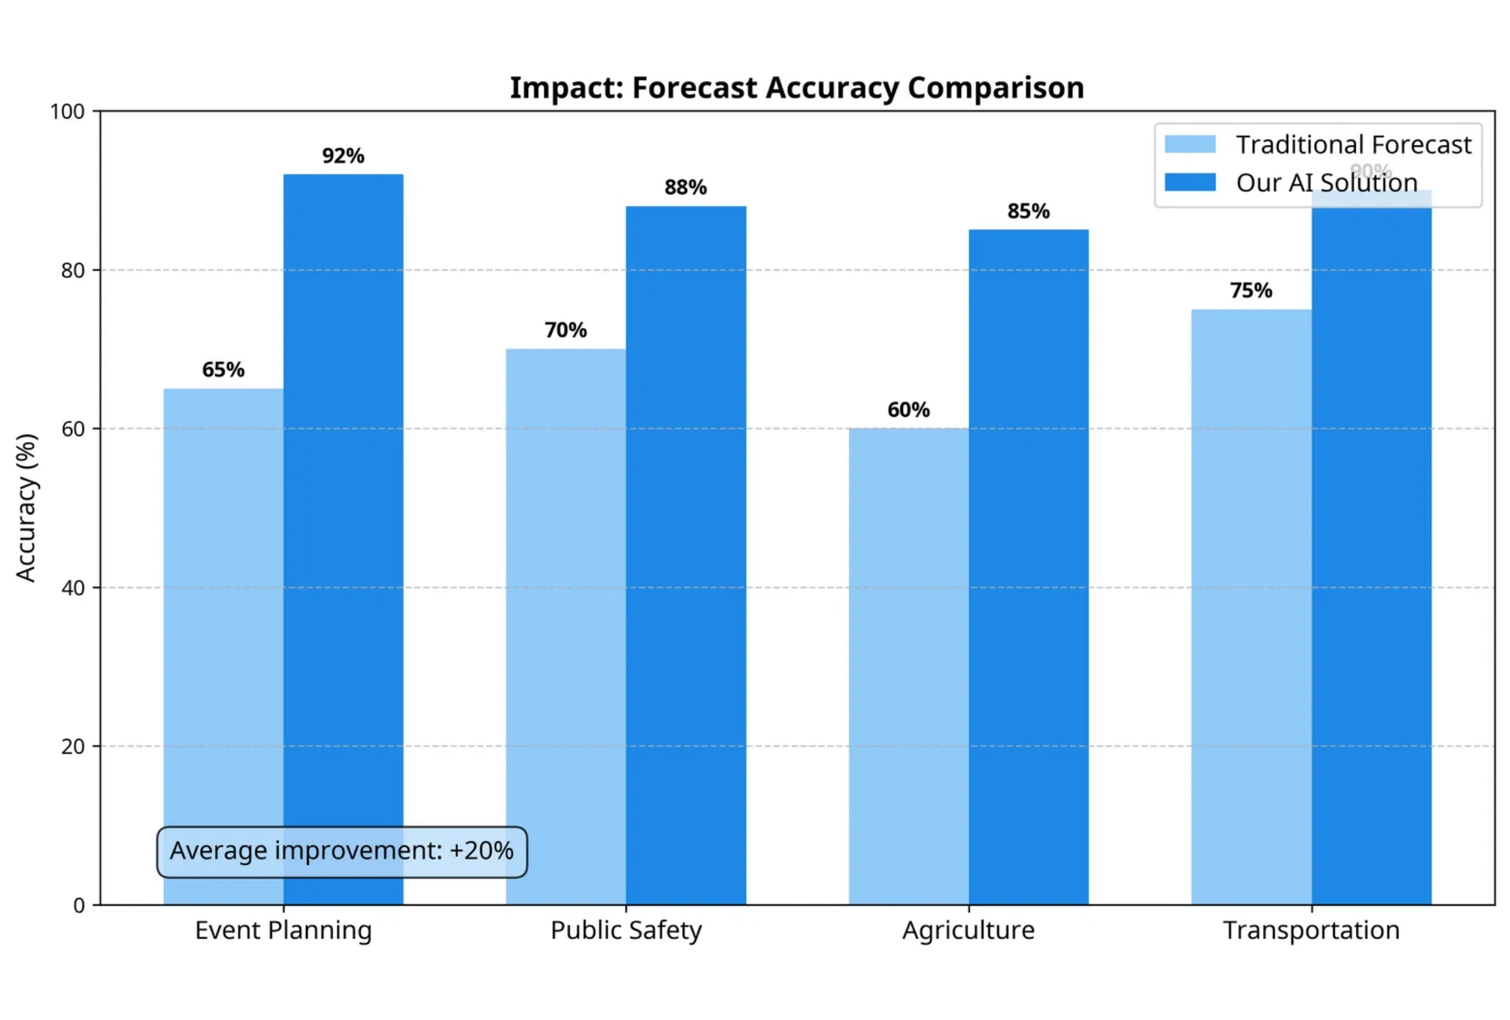
Clear Skies Ahead: Impact & Future Potential
Quantifiable Benefits
Event Planning
92% accuracy for 7-day forecasts enables confident scheduling of outdoor events
Public Safety
Early warning capabilities reduce evacuation time by up to 45 minutes
Agriculture
Potential to reduce crop losses by 15% through precise precipitation forecasts
Future Expansion
Our solution can be scaled to provide hyperlocal forecasts for any location globally, with potential integration into smart city infrastructure and emergency response systems.

Slide 7
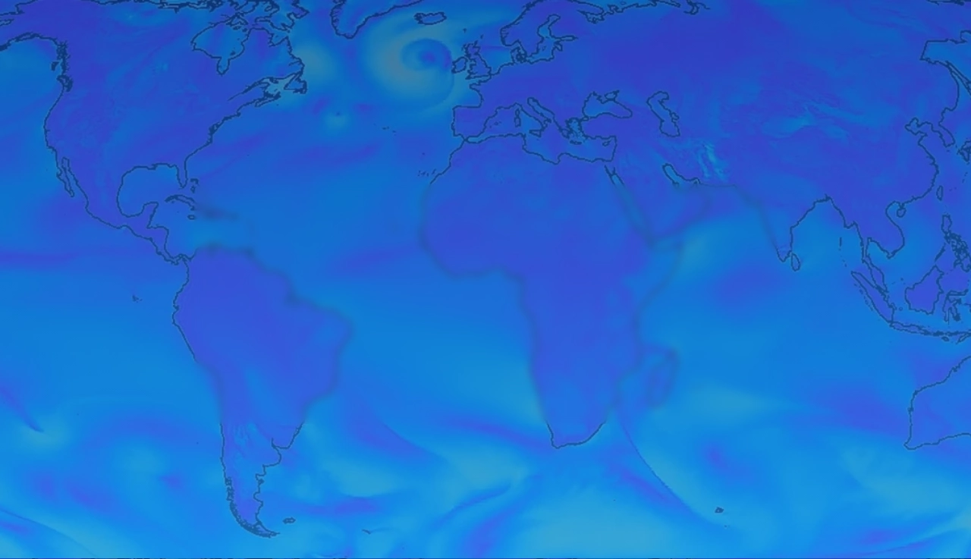



Thank You!
"Will It Rain On My Parade?"
Ready to experience weather prediction with NASA-powered accuracy?
Try Our Demo
rayyannabeel22@gmail.com
https://github.com/Sidra-009/Will_it_rain/tree/main
https://rain-chance-predictor-ucdxx8ht8ybz8r4wt4cjln.streamlit.app/
NAS A Space Apps Challenge 2025
Team StellarLogic

